Slide 1

SPAM DETECTION USING NAIVE BAYES
Under the Supervision of Mrs. Juhi Jain
SUBMITTED BY:
TEJAS HARISH BORKAR 2K18/CO/373
TUSHAR AHUJA 2K18/CO/374
(Group No : 9)

Slide 2
OBJECTIVE:
Our goal was to code a spam filter from scratch that classifies messages as spam and non-spam with an accuracy greater than 80%.
We have used multinomial Naive Bayes Algorithm and conditional probability to achieve it.

Slide 3
EXPERIMENTAL DESIGN:
DATASET:
The datasets have been downloaded from three sources :
https://archive.ics.uci.edu/ml/datasets/sms+spam+collection
https://www.kaggle.com/ozlerhakan/spam-or-not-spam-dataset
https://www.kaggle.com/venky73/spam-mails-dataset
Oversampling had to be done as the datasets were imbalanced.

Slide 4
OVERSAMPLING
Oversampling is used to adjust the class distribution in a data set. In other words, it helps to adjust the ratio between the different classes/categories represented by the dataset.
We performed over-sampling of the spam messages by adding spam entries to the dataset.
The ratio of spam:ham before over-sampling: 14:86
The ratio of spam:ham after over-sampling: 36:64

Slide 5
RESEARCH VARIABLES:
Dependent variable
The dependent variable is the label that is whether the message is classified as spam/ham.
It is a nominal variable.
Independent variable
These are the indices of the words stored in vocabulary (0 to total no. of words in vocabulary-1).
It is a metric ratio variable as real 0 has a meaning that is the absence of a word.

Slide 6
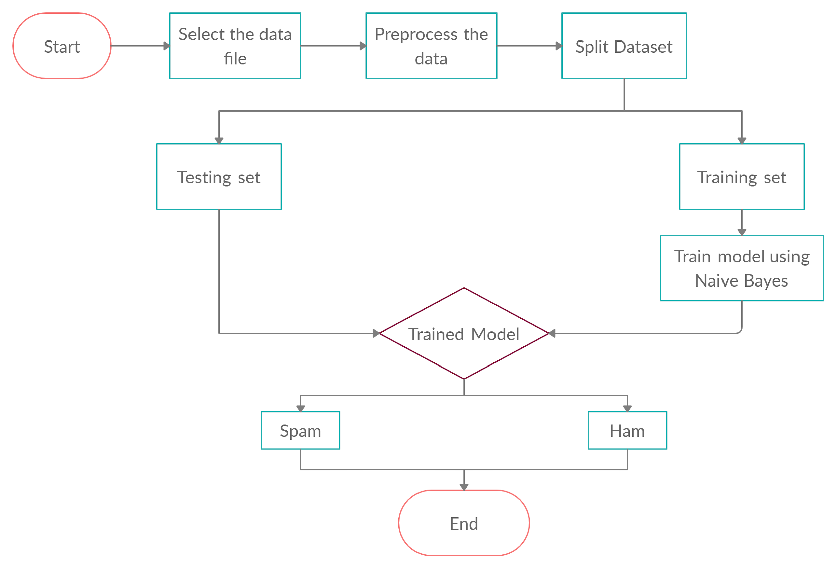
Spam detection using Naive Bayes

Slide 7
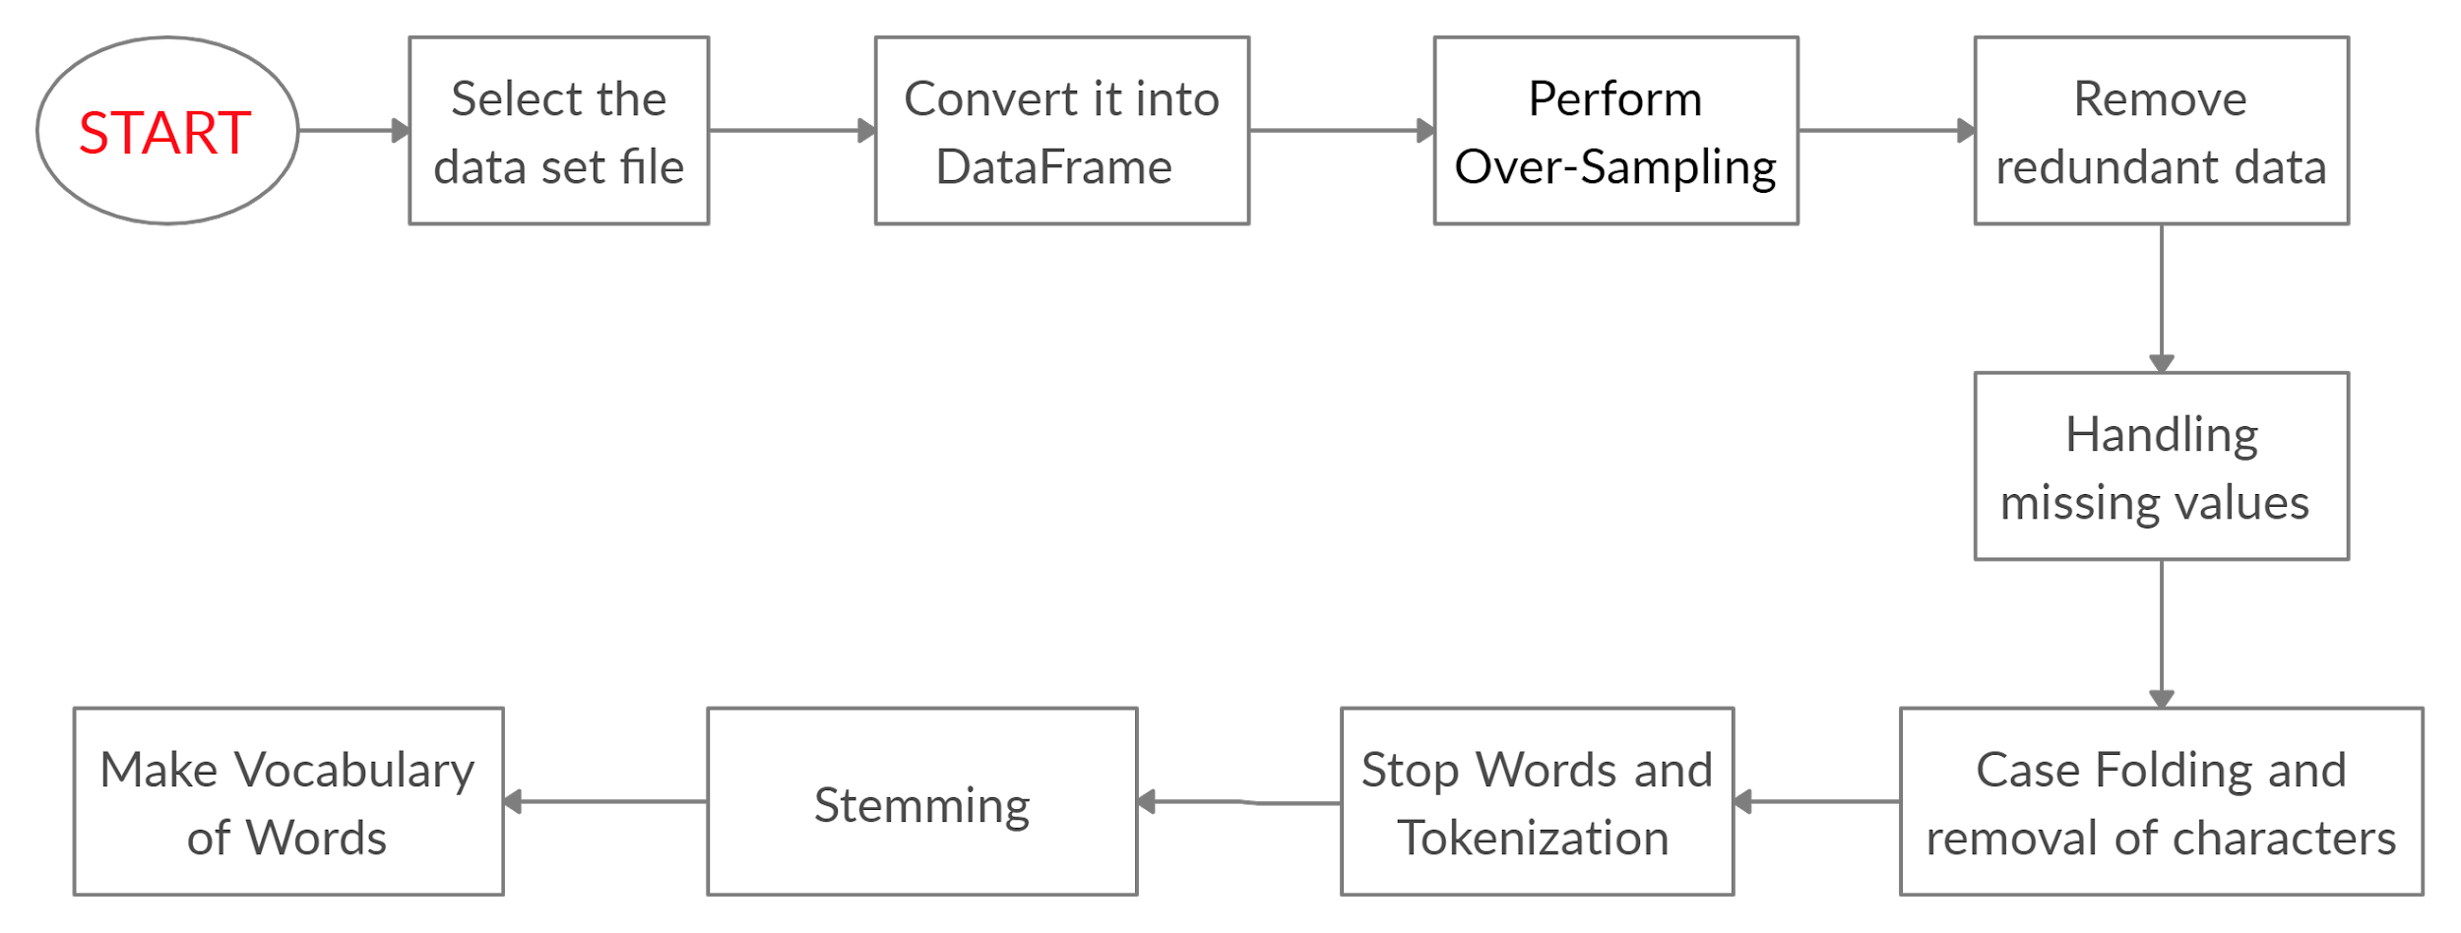
Preprocessing of Data

Slide 8
PREPROCESSING TECHNIQUE:
Handling missing values: We handle missing values by :
Deleting the row if Email is missing.
Replacing missing values with ham if the label is missing so that there is no risk of data loss.
Handling redundant values: We delete the duplicate rows that is we keep only a single instance of every message.
Case Folding and removal of characters: All the text is converted to lowercase and characters other than letters, numbers and punctuation are deleted.
Removing Stop Words and Tokenization: In this process, we remove stopwords and tokenization is carried out to break the string into tokens or individual words.
Stemming
Vocabulary creation.

Slide 9
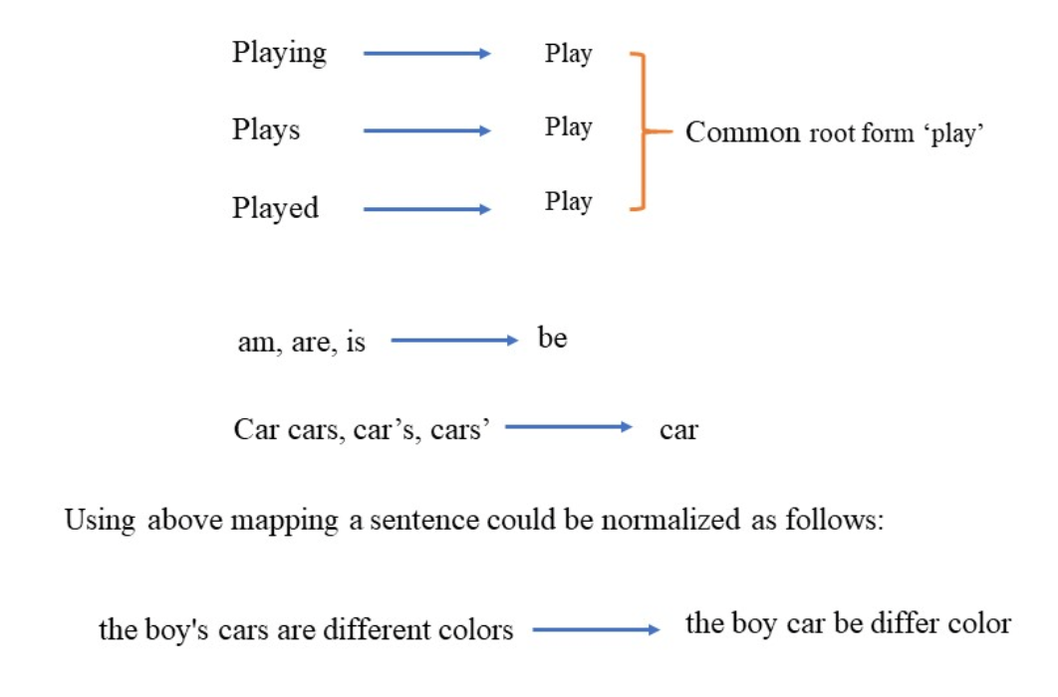
STEMMING

Slide 10
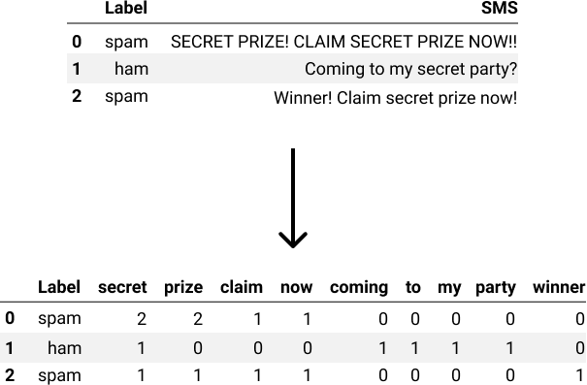
CREATING THE VOCABULARY
Note: This image is for representational purposes only. In the actual model , the indices of words in vocabulary are used as the independent variables.

Slide 11
DATA ANALYSIS TECHNIQUE:
Naive Bayes
The Naive Bayes algorithm is primarily based on Bayes’ theorem with the assumption of independence between predictors.
A Naive Bayesian model is relatively easy to build, as there is no complicated iterative parameter estimation. This makes it useful for massive datasets.
Despite its simplicity, it does surprisingly well and is extensively used because it performs better than some sophisticated classification methods.

Slide 12
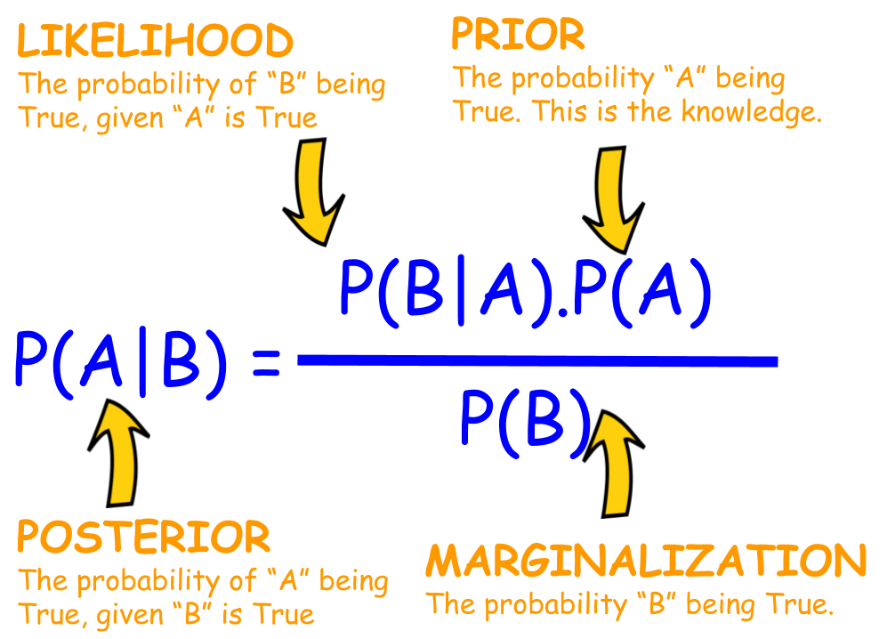
Algorithm
The Bayes theorem enables us to calculate the posterior probability P(A|B) from P(A), P(B), and P(B|A).
Naive Bayes classifiers are based on the assumption that the effect of the value of the predictor (B) on a given class (A) is independent of the values of other predictors.
This is known as
class conditional
independence.

Slide 13


We have used Naive Bayes classifier as our data analysis technique to build spam detection filter models. Naive Bayes is primarily based on Bayes Theorem.
If P(Spam | w₁,w₂, ..., w_{n}) is greater than P(Ham | w₁,w₂, ...,w_{n}), then the message is spam else it is ham.

Slide 14
Advantages of Naive Bayes
When the assumption of independent predictors holds, a Naive Bayes classifier performs better as compared to other models.
A small amount of training data is used to estimate the test data. So, the training period is less.
It is easy to implement.

Slide 15
Disadvantages of Naive Bayes
One of the main limitations is the assumption of independent predictors. An essential premise of the algorithm is conditional independence. But in many situations, it is impossible to get an entirely an independent set of predictors.
Suppose a categorical variable has a category in the testing data set, which was not previously observed in the training data set. In that case, the model assigns a 0 probability and will be unable to make a prediction which is often known as Zero Frequency. We can use smoothing technique.s to solve this issue. One of the most straightforward smoothing techniques is called Laplace estimation.

Slide 16
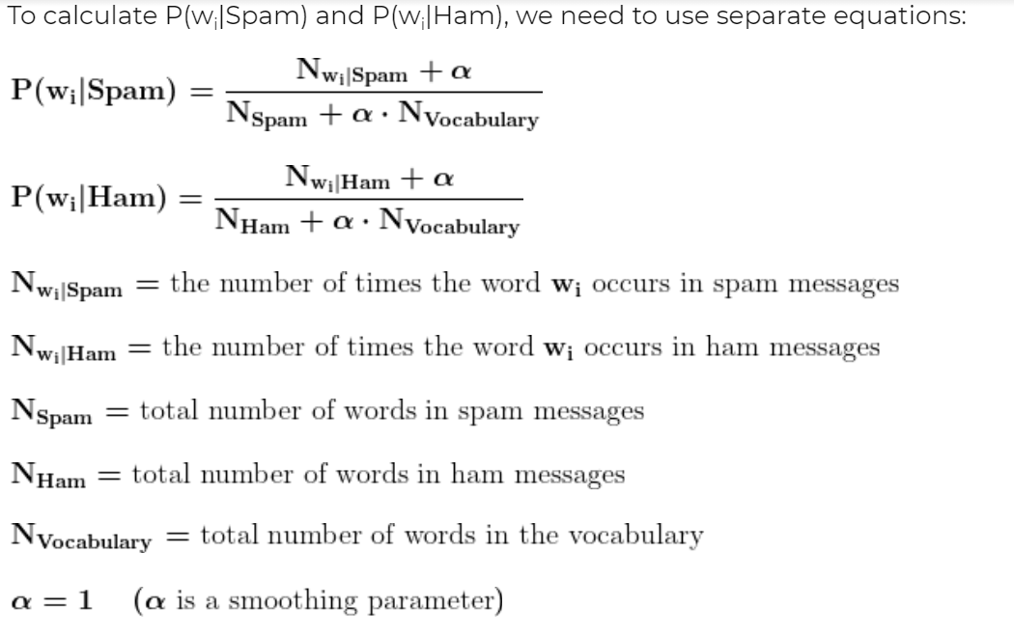
We also use Laplace smoothing and set

Slide 17
Classifying A New Message
Take as input a new message (w1, w2, ..., wn).
The values of P(Spam|w1, w2, ..., wn)=x and P(Ham|w1, w2, ..., wn)=y are calculated and compared.
If y > x, then the message is classified as ham.
If x < y, then the message is classified as spam.
If x = y, then the algorithm may request human help.
Some messages may contain words that are not part of the vocabulary. Such words are ignored while calculating the probabilities.

Slide 18
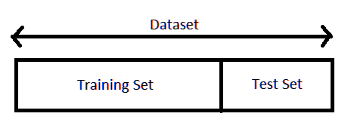
VALIDATION TECHNIQUES:
Hold out validation:
The dataset is split into a training set and a test set.
80% of the data is used for training and the remaining 20% for testing.

Slide 19
Stratified K-Folds cross-validation
In Stratified Sampling, let the population of a state be 55.7% male and 44.3% female. If we wish to choose 1000 people from that state and if 557 male ( 55.7% of 1000 ) and 443 female ( 44.3% for 1000 ), i.e. 557 male + 443 female (Total=1000 people) are picked for their opinion, then this chosen group of people represent the entire state.
Stratified k-fold cross-validation is the same as just k-fold cross-validation, but in Stratified k-fold cross-validation, stratified sampling is done instead of random sampling.

Slide 20
PERFORMANCE MEASURES:
Accuracy: The ratio of the number of correct predictions to the total predictions made.
Accuracy = (TP+TN)/total
False Positive (FP): The number of misclassified non-spam emails.
False Negative (FN): The number of misclassified spam emails
True Positive (TP): The number of spam messages correctly classified as spam.
True Negative (TN): The number of non-spam emails correctly classified as non-spam.

Slide 21
Recall: Percentage of spam messages managed to block.
r = TP/(TP+FN)
Precision: Percentage of correct message for spam emails.
p = TP/(TP+FP)
F Beta-measure: Weighted average of precision and recall.
F-Beta-measure = (1+beta2)p*r / (beta2)(p+r)

Slide 22
In case if FP and FN both are equally important then we use beta = 1
In case if FP is more important than FN then we reduce beta value (between 0 to 1)
In case if FN is more important than FP than we increase beta value (greater than 1)
In our case if a ham message arrives and if the model reports this message as spam then this is a big trouble for the user/client i.e number of misclassified non spam emails is important (False Positive) .
So we will use beta = 0.5 (also known as F0.5 score)
F0.5 score = 5*p*r/(p+r)

Slide 23

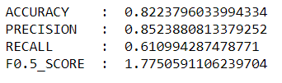
PERFORMANCE
Using Hold out Validation
Stratified K-Folds cross-validation

Slide 24
CONTRIBUTION
Tejas :
Data Cleaning
Naive Bayes algorithm
Performance Measures
Tushar :
Oversampling
Vectorisation
Validation Techniques

Slide 25
REFERENCES
Arifin, D. D., & Bijaksana, M. A. (2016, September). Enhancing spam detection on mobile phone Short Message Service (SMS) performance using FP-growth and Naive Bayes Classifier. Google.com. In 2016 IEEE Asia Pacific Conference on Wireless and Mobile (APWiMob) (pp.80-84). IEEE.
https://app.creately.com/ for creating flow charts.
https://www.kaggle.com/ for datasets.

Slide 26
THANK YOU

